Slide 1


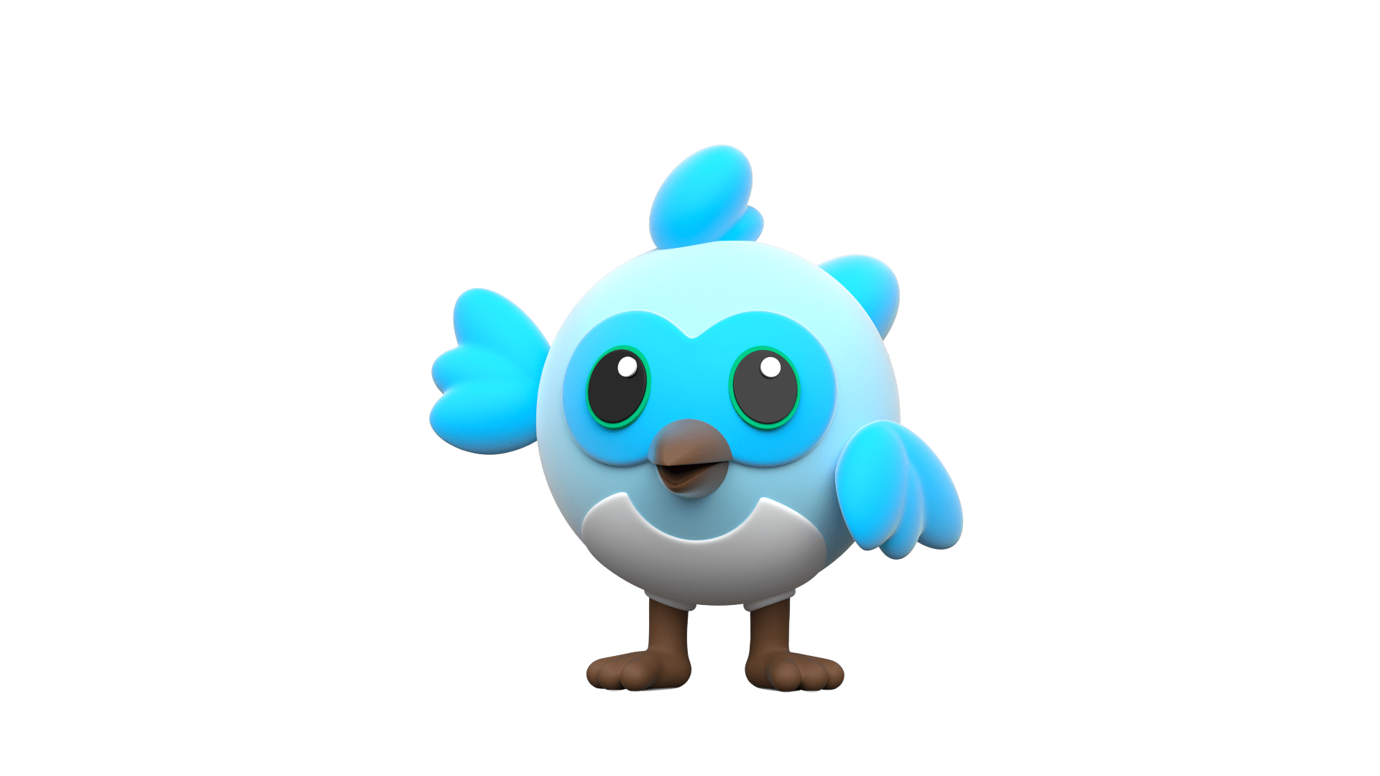
FUNdamentals & Deep Dive
FAQ,
Tips and Tricks Why Flutter? … wait what’s Flutter?...
FUNdamentals and Hands on…

Slide 2



Anilson Monteiro
From Telecommunications Degree to
Full Stack Developer by <Academia de Codigo_>
Cloud Enthusiast
JS enthusiast
Lifelong Learner

Slide 3

What we’ll do today?
Session 1 → Fundamentals
Flutter FAQ
Dart and OOP Programing - A Quick Tour
JS to Dart - A Quick Tour
Dart - A Quick Tour - Recap
Setup and Installation & Intro to Flutter Development
The Hello World - Cont.
Flutter: The Basics - Recap

Slide 4
What we’ll do today?
Session 2 → Deep Dive
Tips and Tricks That Actually Works
Hands On & Mini Projects
Deployment
What else?

Slide 5
Requirements
Programing Basics
Developer Spirit ;)
Notes:
Vamos precisar de 2 coisas
1 basico de programacao e 2 um espirito de desenvolvedor
Porque sabemos que todos os dias como devs enfrentamos erros entao se algo der errado nao julgem pois ja sabem como eh o dia a dia do developer
E persistencia se der erro vamos continuar ate achar uma solucao

Slide 6

FUNdamentals
Let’s have fun…!

Slide 7
Session 1 → Fundamentals
Flutter FAQ
Dart and OOP Programing - A Quick Tour
JS to Dart - A Quick Tour
Dart - A Quick Tour - Recap
Setup and Installation & Intro to Flutter Development
The Hello World - Cont.
Flutter: The Basics - Recap
hands on work
Little challenges
Basic to
“Advanced”
FUNdamentals
Notes:
Basic to advanced… well not so advanced because what is advanced things? Just things we dont know yet, when you master it then it becomes simple things

Slide 8

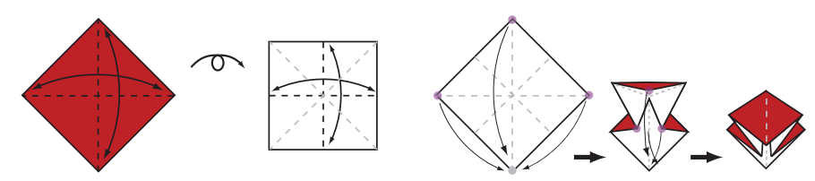

“Mastering the fundamentals is challenging, requires practice, but can be fun.”
Notes:
Dominar os funcamentos pode ser desafiador, requer muita pratica mas ao final o que realmente eh importante eh aproveitar o percurso porque ao final vamos acabar sendo capazes de fazer coisas incriveis
Um exemplo eh fazer um origme de papel para quem nunca fez parece disafiador, mas para uma crianca por exemplo imaginem o quao divertido eh para ela fazer isto e ao final estas a criar algo novo apartir de um simples pedaco de papel

Slide 9
hands on work
Little challenges
Basic to
“Advanced”
FUNdamentals
#1
Flutter FAQ
Why Flutter? Wait What’s Flutter? Is it that? Who build Flutter? What can i do with it? Why Dart?
Notes:
Basic to advanced… well not so advanced because what is advanced things? Just things we dont know yet, when you master it then it becomes simple things

Slide 10
Introduction
As a cross-platform framework, Flutter most closely resembles React Native. Both allow for a reactive and declarative style of programming. Unlike React Native, however, Flutter doesn’t need to use a JavaScript bridge, which improves app startup times and overall performance. Dart achieves this by using Ahead-Of-Time (AOT) compilation.
Dart can also use Just-In-Time (JIT) compilation. JIT compilation with Flutter improves the development workflow by allowing a hot reload capability to refresh the UI during development without the need for an entirely new build.
https://www.raywenderlich.com/24499516-getting-started-with-flutter
Notes:
Basic to advanced… well not so advanced because what is advanced things? Just things we dont know yet, when you master it then it becomes simple things

Slide 11
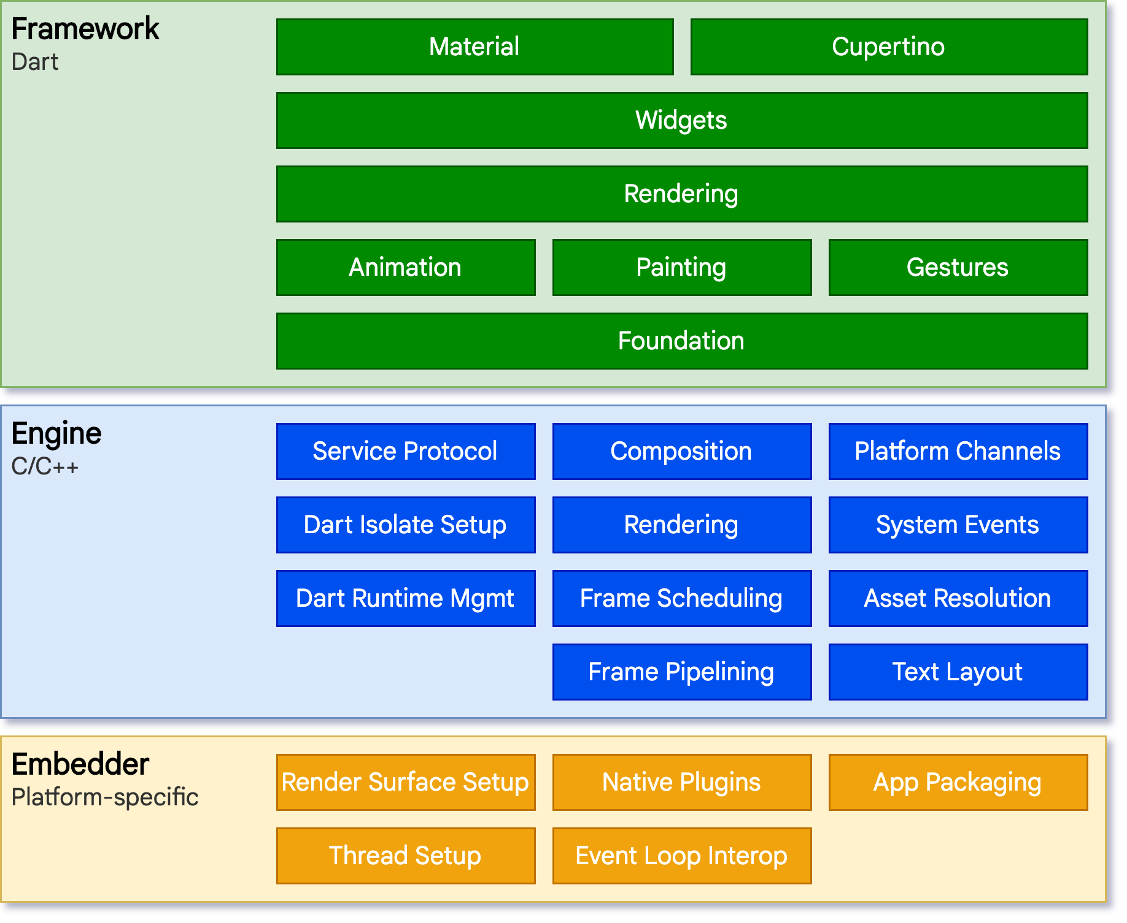
Architecture
How does it works?
https://docs.flutter.dev/resources/architectural-overview
Notes:
Basic to advanced… well not so advanced because what is advanced things? Just things we dont know yet, when you master it then it becomes simple things

Slide 12
Concepts
AOT (Ahead of Time) Compilation
ahead-of-time compilation(AOT compilation) is the act of compiling an often higher-level programming language into an often lower-level language before execution of a program, usually at build-time, to reduce the amount of work needed to be performed at run time
Compilation vs Transpilation (Source-to-source compiler or a source-to-source translator)
a type of translator that takes the source code of a program written in a programming language as its input and produces an equivalent source code in the same or a different programming language
https://docs.flutter.dev/resources/architectural-overview
Notes:
Basic to advanced… well not so advanced because what is advanced things? Just things we dont know yet, when you master it then it becomes simple things

Slide 13
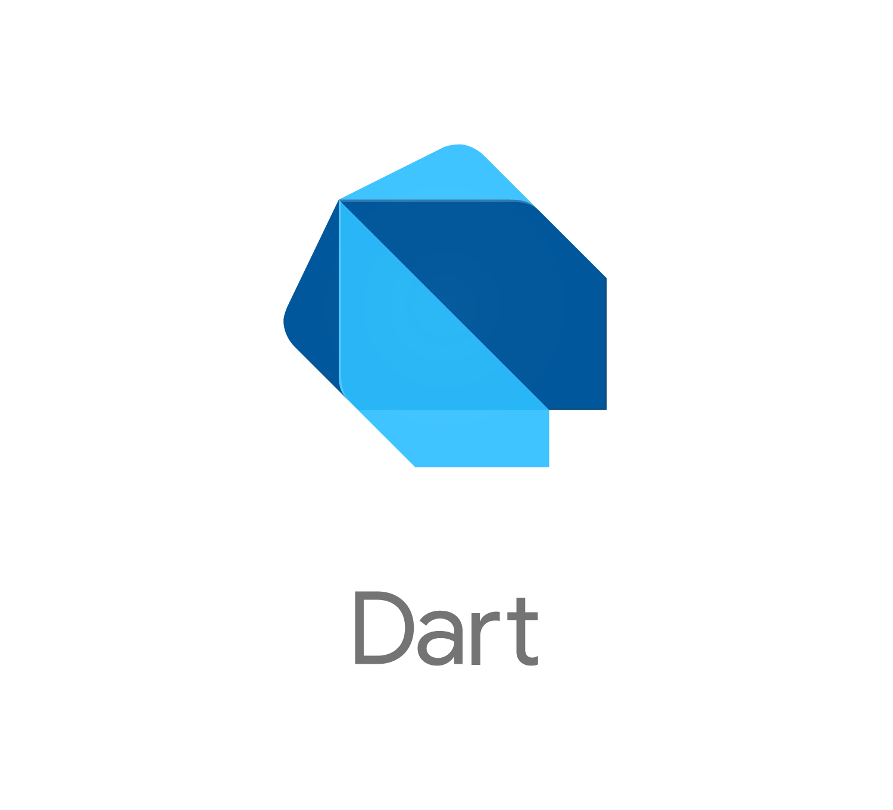
hands on work
Little challenges
Basic to
“Advanced”
FUNdamentals
#2
Dart and OOP Programing
- A Quick Tour
Dart is all about OOP...
if in Java everything is objects, in Flutter everything is widgets
Notes:
Basic to advanced… well not so advanced because what is advanced things? Just things we dont know yet, when you master it then it becomes simple things

Slide 14
Introduction
Dart is the programming language for Flutter, the cross-platform development framework from Google that has taken the mobile world by storm. With Flutter and Dart, you can use a single code base to builds apps for iOS, Android, the web, and even the desktop and beyond.
Dart is a modern and powerful language that is similar in many ways to languages like Java, Swift, and Kotlin. The similarities can be a great advantage when learning Dart, but the subtle differences can be hard to remember and so getting started with Dart can be a challenge.
https://www.raywenderlich.com/4482580-dart-2-cheat-sheet-and-quick-reference-2019
Notes:
Basic to advanced… well not so advanced because what is advanced things? Just things we dont know yet, when you master it then it becomes simple things

Slide 15
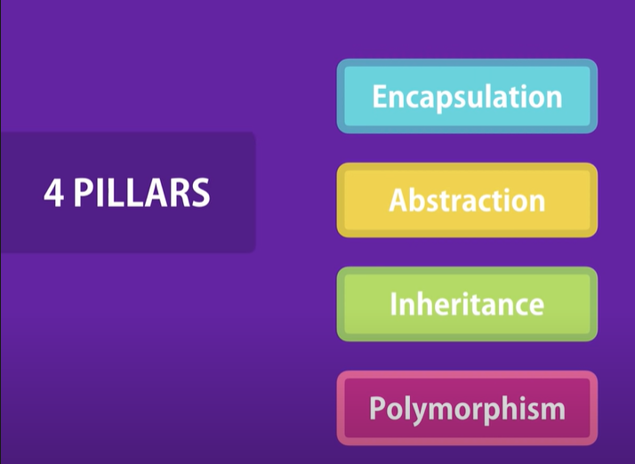
The principles of OOP
https://youtu.be/pTB0EiLXUC8
Notes:
Basic to advanced… well not so advanced because what is advanced things? Just things we dont know yet, when you master it then it becomes simple things

Slide 16
hands on work
Little challenges
Basic to
“Advanced”
FUNdamentals
#3
JS to Dart - A Quick Tour
Coming from JS? Let’s see that Dart is not that monster after all
Notes:
Basic to advanced… well not so advanced because what is advanced things? Just things we dont know yet, when you master it then it becomes simple things

Slide 17
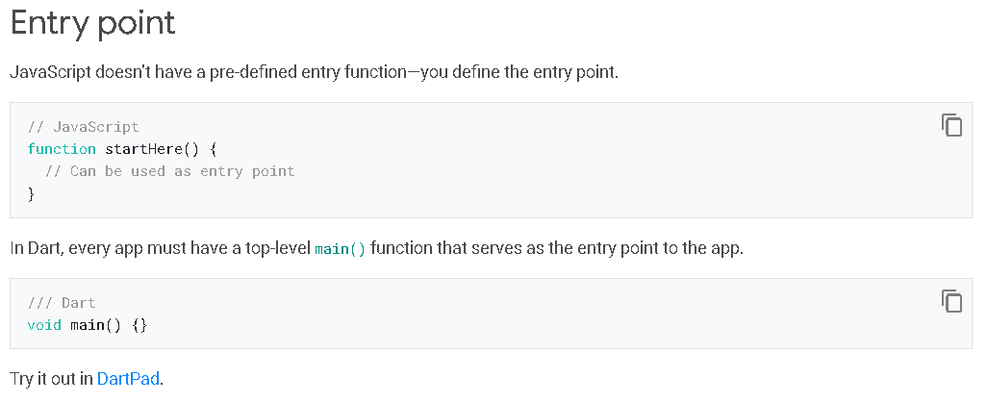
Dart for JavaScript Developers
Lab walkthrough
https://docs.flutter.dev/get-started/flutter-for/react-native-devs#introduction-to-dart-for-javascript-developers
Notes:
Basic to advanced… well not so advanced because what is advanced things? Just things we dont know yet, when you master it then it becomes simple things

Slide 18

hands on work
Little challenges
Basic to
“Advanced”
FUNdamentals
#4
Setup and Installation &
Intro to Flutter Development
How to setup the environment for Flutter Development
Notes:
Vamos celebra nossas primeiras conquistas

Slide 19
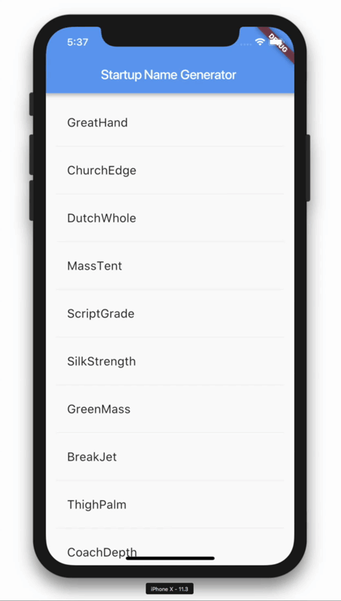
Hello World - Part 1
Lab walkthrough
https://codelabs.developers.google.com/codelabs/first-flutter-app-pt1
Notes:
Basic to advanced… well not so advanced because what is advanced things? Just things we dont know yet, when you master it then it becomes simple things

Slide 20
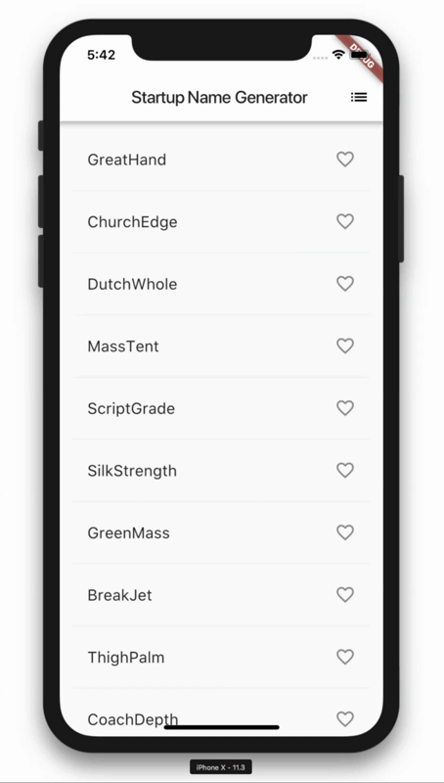
Hello World - Part 2
Lab walkthrough
https://codelabs.developers.google.com/codelabs/first-flutter-app-pt2#0
Notes:
Basic to advanced… well not so advanced because what is advanced things? Just things we dont know yet, when you master it then it becomes simple things

Slide 21
RECAP
What did you just learn?

Slide 22
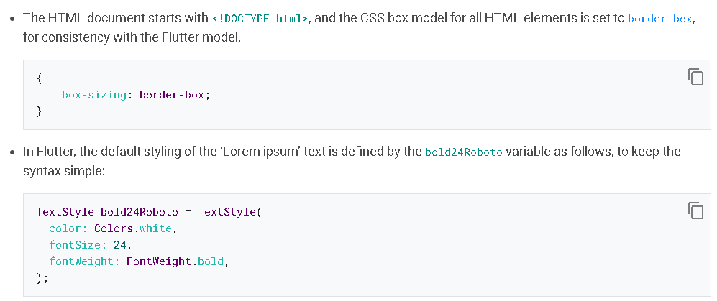
Similarities of Web Development and Flutter development
Lab Walkthrough
https://docs.flutter.dev/get-started/flutter-for/web-devs
Notes:
Basic to advanced… well not so advanced because what is advanced things? Just things we dont know yet, when you master it then it becomes simple things

Slide 23
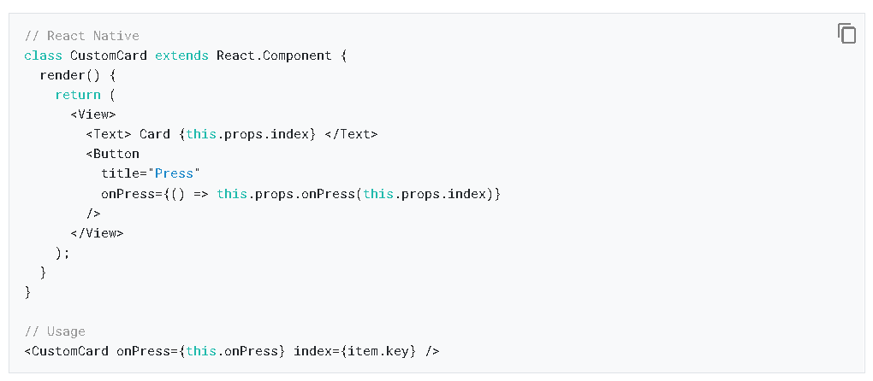
Similarities of React Native and Flutter development
Lab Walkthrough
https://docs.flutter.dev/get-started/flutter-for/react-native-devs
Notes:
Basic to advanced… well not so advanced because what is advanced things? Just things we dont know yet, when you master it then it becomes simple things

Slide 24
QUIZ #1
Complete the Code
Which one is correct
Notes:
Basic to advanced… well not so advanced because what is advanced things? Just things we dont know yet, when you master it then it becomes simple things

Slide 25
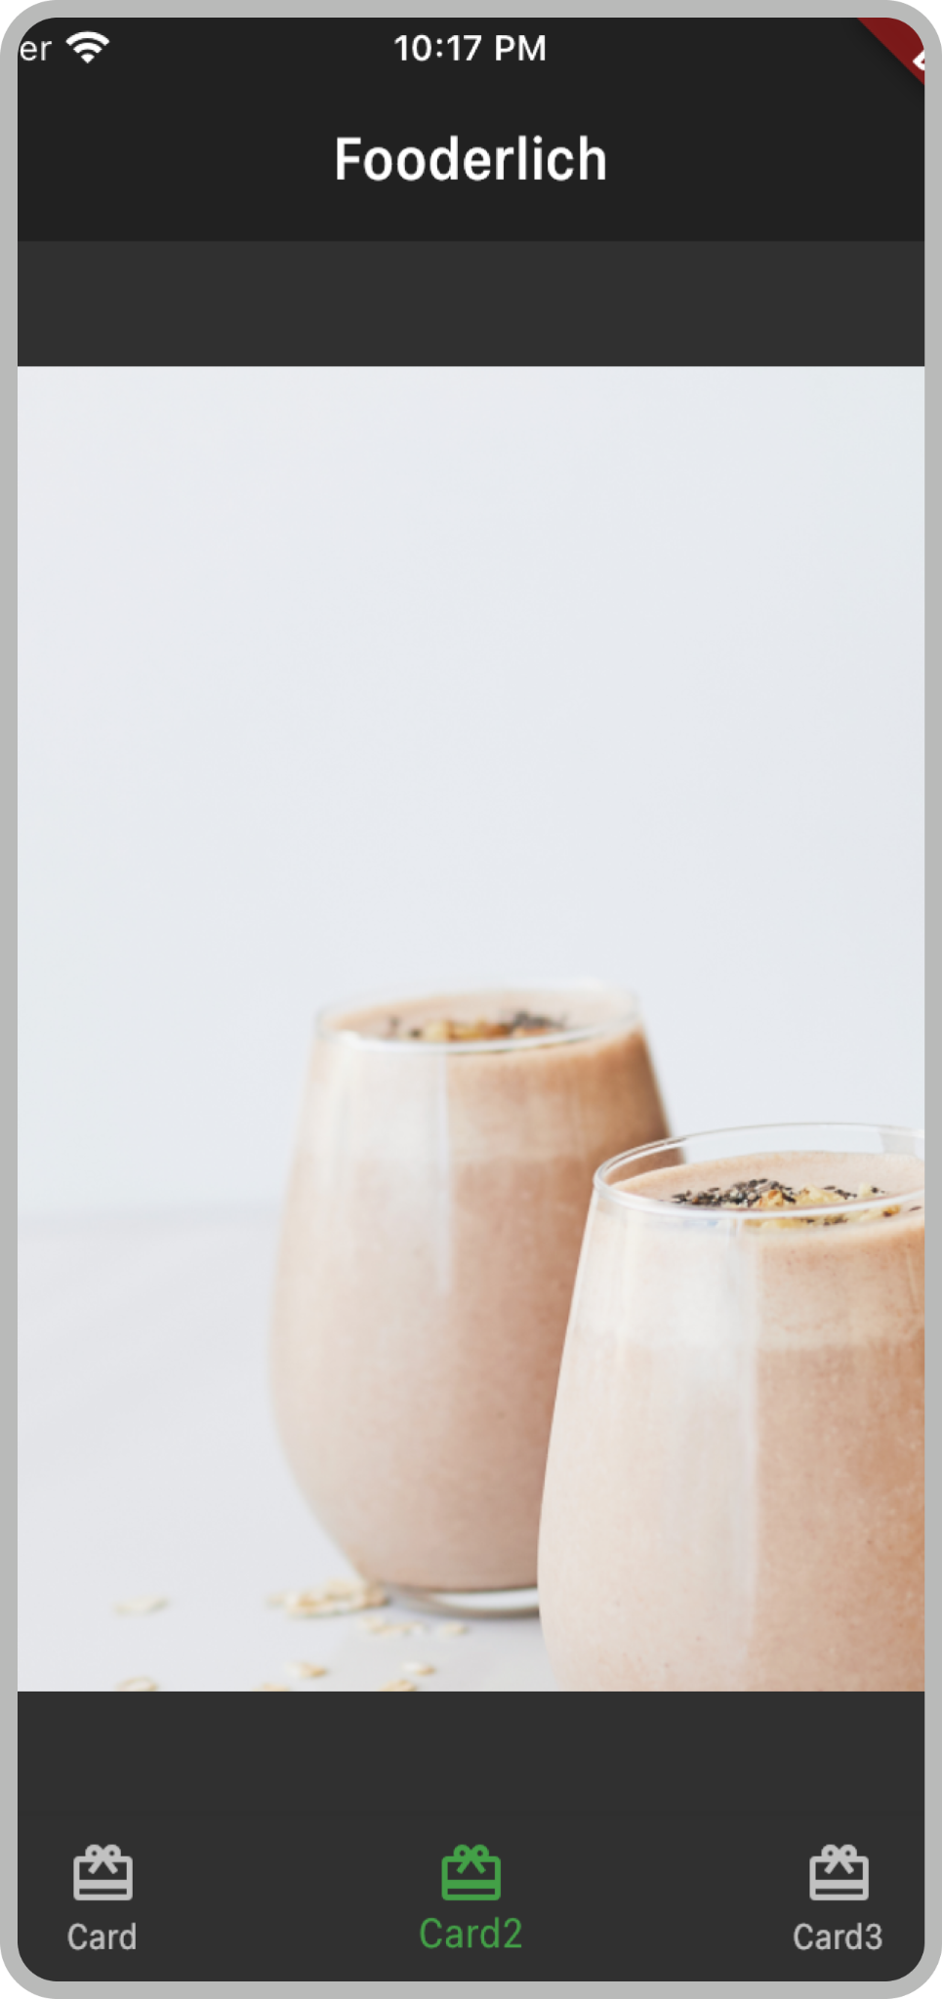
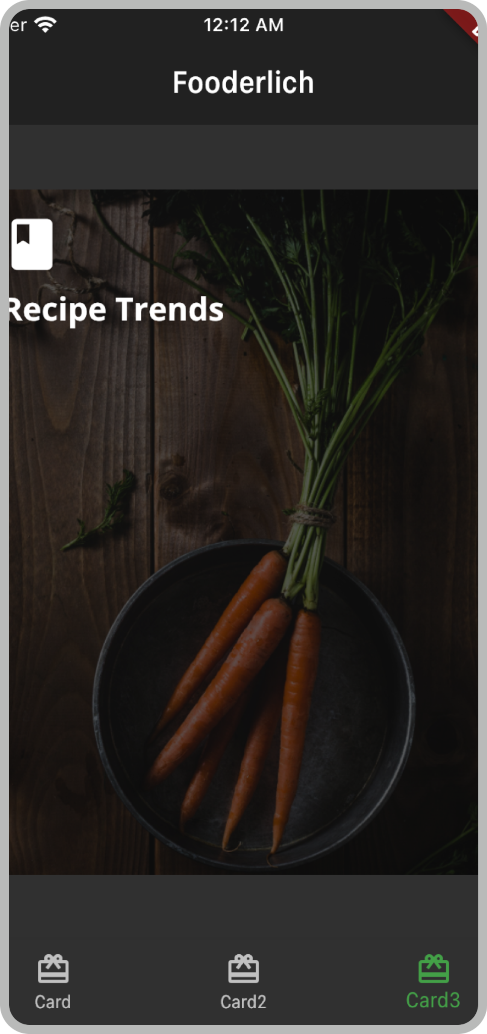
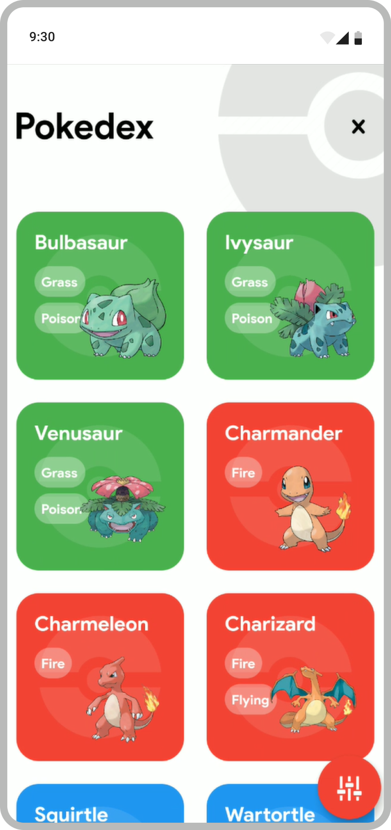
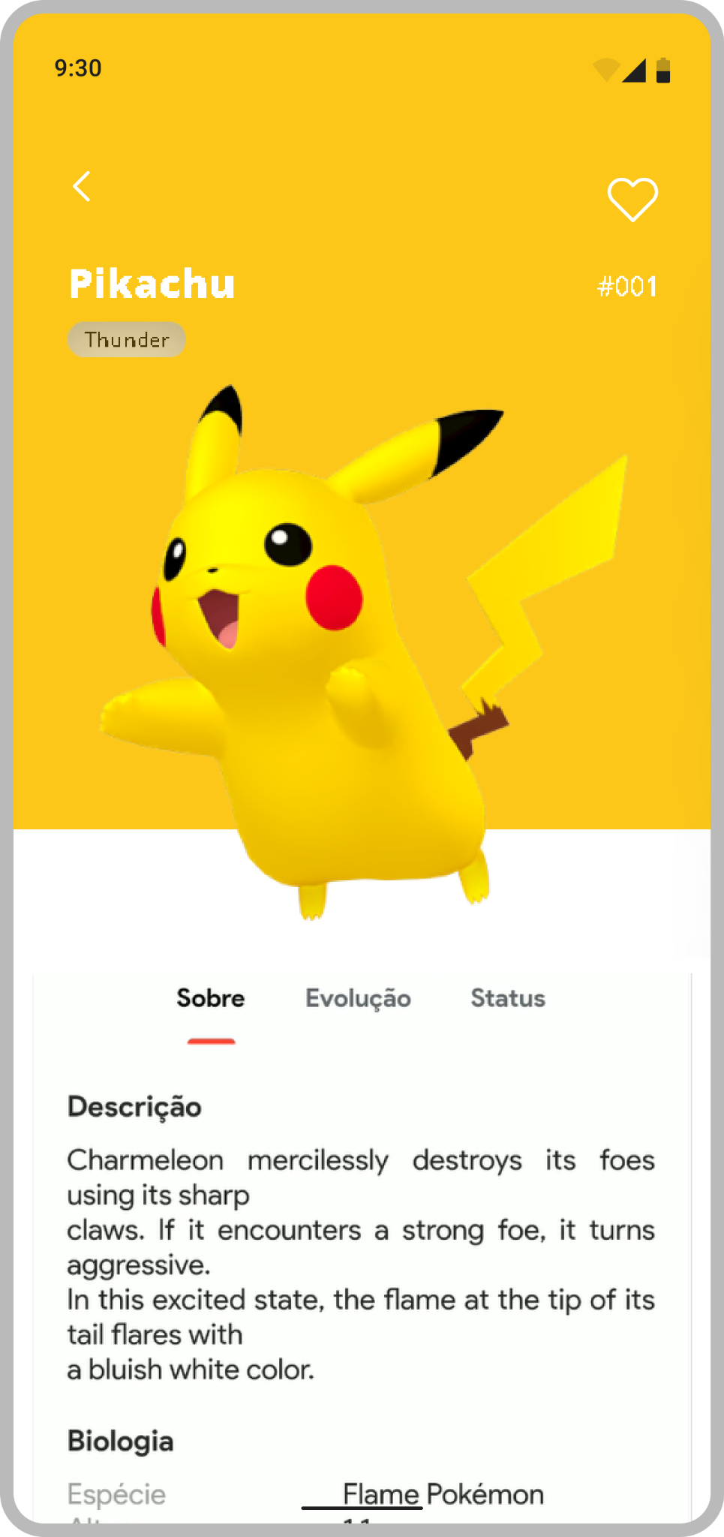


Coming next…
Deep dive

Slide 26
Deep dive
Navigating in deep waters…!

Slide 27
Session 2→ Deep Dive
Tips and Tricks That Actually Works
Hands On & Mini Projects
Deployment
What else?
hands on work
Little challenges
Basic to
“Advanced”
FUNdamentals
Notes:
Basic to advanced… well not so advanced because what is advanced things? Just things we dont know yet, when you master it then it becomes simple things

Slide 28
Project #1 - Fooderlich
https://www.raywenderlich.com/books/flutter-apprentice/v2.0/chapters/3-basic-widgets
Notes:
Basic to advanced… well not so advanced because what is advanced things? Just things we dont know yet, when you master it then it becomes simple things

Slide 29
Project #2 - Pokedex
https://www.raywenderlich.com/5896601-flutter-networking-tutorial-getting-started
Notes:
Basic to advanced… well not so advanced because what is advanced things? Just things we dont know yet, when you master it then it becomes simple things

Slide 30
hands on work
Little challenges
Basic to
“Advanced”
FUNdamentals
#5
🚀
Deployment
How we can build and deploy a Flutter app? ...
Well, just the steps, we can’t do it all in one day...
Unfortunately 😭
Notes:
Vamos celebra nossas primeiras conquistas

Slide 31
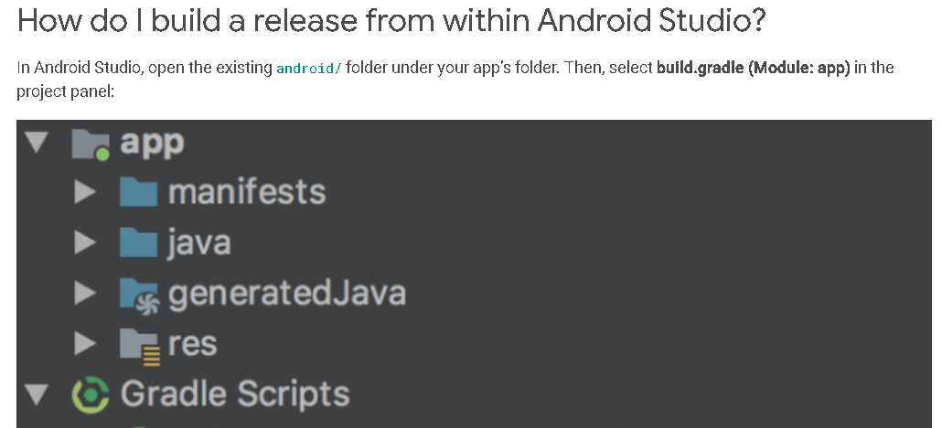
Flutter Apps - Deployment Steps
Deployment steps walkthrough
https://docs.flutter.dev/deployment/android
Notes:
Basic to advanced… well not so advanced because what is advanced things? Just things we dont know yet, when you master it then it becomes simple things

Slide 32
hands on work
Little challenges
Basic to
“Advanced”
FUNdamentals
#6
🌍
What else is out there?
There is more to do on the web
Notes:
Vamos celebra nossas primeiras conquistas

Slide 33
Project #3 - Andela Web Clone
https://andela.com/for-engineers/
Notes:
Basic to advanced… well not so advanced because what is advanced things? Just things we dont know yet, when you master it then it becomes simple things

Slide 34


hands on work
Little challenges
Basic to
“Advanced”
FUNdamentals
#7
A little Challenge
We saw how to develop for mobile and Web
Now is your turn to share with us something from the desktop… yes it’s possible too!
Desktop
Notes:
Vamos celebra nossas primeiras conquistas

Slide 35
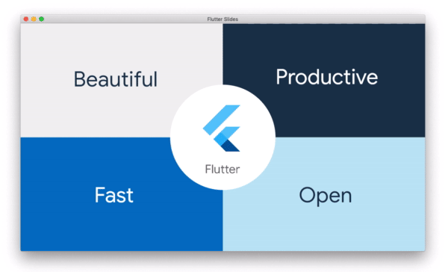
Flutter Slides - Demo
Flutter Desktop demo
https://verygood.ventures/success-stories/flutter-slides
Notes:
Basic to advanced… well not so advanced because what is advanced things? Just things we dont know yet, when you master it then it becomes simple things

Slide 36
hands on work
Little challenges
Basic to
“Advanced”
FUNdamentals
#8
The end
Well, not yet…
Notes:
Vamos celebra nossas primeiras conquistas

Slide 37
A quick look into the community
Things we can find on the Flutter community
The Boring Flutter Show
The widget of the week
Animations - Community events
Book club - Community events
#30daysofcode
Puzzle Hackathon
https://flutterhack.devpost.com/ https://docs.flutter.dev/apprentice-giveaway
Notes:
Basic to advanced… well not so advanced because what is advanced things? Just things we dont know yet, when you master it then it becomes simple things

Slide 38
Final thoughts
Learn the most you can
Don’t skip steps
Celebrate the little victories
Don’t give up on first bug
Look and ask for help (do your homework first)
Give back and support the community (there is plantly of to do it)
Teach what you learn (even if it’s a hello world)
Enjoy the path and
have FUNdamentals in mind
Always look for the next challenge
hands on work
Little challenges
Basic to
“Advanced”
FUNdamentals
Notes:
So learn because in this field learning eh para vida toda, aceitando isso a jornada podera ser mais tranquila
Eh uma jjornada feita de pequenos passos
e pequenas vitorias
Bugs, sempre vao existir as vezes nos mesmos criamos nossos bugs
Vale sempre procurar ajuda mas nao sem antes fazer seu trabalho de casa
Dar devolta a comunidade ha diversas formas de contribuir com projectos opensource e nao so consumir do stack overfllow ou de projectos abertos no github eh uma forma de evoluir para o proximo nível
Ou entao ensinar algo a outros msm que seja algo basico ha sempre algem precisando de um pequeno empuram para avancar as veses pode ser uma simples virgula ou corrigir um bug
E sempre tenham em mente os fundamentos e aproveitem a jornada faznedo o que gostam se estam aqui eh por algum motivo seja qual for agarem a esse motivo e aceitem o proximo desafio

Slide 39
Are you still
here?
Notes:
So learn because in this field learning eh para vida toda, aceitando isso a jornada podera ser mais tranquila
Eh uma jjornada feita de pequenos passos
e pequenas vitorias
Bugs, sempre vao existir as vezes nos mesmos criamos nossos bugs
Vale sempre procurar ajuda mas nao sem antes fazer seu trabalho de casa
Dar devolta a comunidade ha diversas formas de contribuir com projectos opensource e nao so consumir do stack overfllow ou de projectos abertos no github eh uma forma de evoluir para o proximo nível
Ou entao ensinar algo a outros msm que seja algo basico ha sempre algem precisando de um pequeno empuram para avancar as veses pode ser uma simples virgula ou corrigir um bug
E sempre tenham em mente os fundamentos e aproveitem a jornada faznedo o que gostam se estam aqui eh por algum motivo seja qual for agarem a esse motivo e aceitem o proximo desafio

Slide 40
Don’t loose
next episodes…
Thank you👋
Notes:
So learn because in this field learning eh para vida toda, aceitando isso a jornada podera ser mais tranquila
Eh uma jjornada feita de pequenos passos
e pequenas vitorias
Bugs, sempre vao existir as vezes nos mesmos criamos nossos bugs
Vale sempre procurar ajuda mas nao sem antes fazer seu trabalho de casa
Dar devolta a comunidade ha diversas formas de contribuir com projectos opensource e nao so consumir do stack overfllow ou de projectos abertos no github eh uma forma de evoluir para o proximo nível
Ou entao ensinar algo a outros msm que seja algo basico ha sempre algem precisando de um pequeno empuram para avancar as veses pode ser uma simples virgula ou corrigir um bug
E sempre tenham em mente os fundamentos e aproveitem a jornada faznedo o que gostam se estam aqui eh por algum motivo seja qual for agarem a esse motivo e aceitem o proximo desafio

Slide 41
Links and additional resources
Github repo link

